Slide 1
Targeting Business Users
With
Decision Table Classifiers
Ron Kohavi and Daniel Sommerfield
Presented by Andi Baritchi on 10/14/99
CSE 6362 Data Mining, Dr. Diane Cook
andi@airmail.net
www.biggerbox.com

Slide 2

Classifiers for Business
Business users commonly use spreadsheets & 2D plots to analyze their data.
Most machine learning research has been focused on models too complicated for business users.

Slide 3
Presentation Flow
Goals of decision table classifiers
Evaluation of current classifiers
Decision tables
Decision table classifiers
Empirical evaluation
Visualizing decision tables
Conclusions

Slide 4
Goals of Decision Table Classifiers
To classify data quickly with low error rates
To use a low number of attributes and produce small, easily understandable classifiers
(Opt) Visualizer: to graphically represent the classifier in an easy to read format

Slide 5
Naïve Bayes and Decision Trees (Business Evaluation)
Business clients found naïve Bayes much more interesting than decision trees
Decision trees also found interesting patterns but the clients were uncomfortable with the decision tree structure

Slide 6
Need for a Better Model
Naïve Bayes & decision trees are too complex for business users to understand.
Business users need something that produces small, easy to understand classifiers. A spreadsheet-like classifier model that can be represented visually with good clarity.

Slide 7
Decision Table
Flat training set data with most attributes stripped off
Only “important” attributes remain. (Choosing attributes is explained later.)

Slide 8
Decision Table Example (Original Training Set Table)
Physician-fee-freeze | Mx-missile | Export-admin-to-South-Africa | Label
Y | Y | Y | Republican
Y | N | Y | Republican
N | N | Y | Democrat
Y | N | N | Republican
N | Y | Y | Democrat
N | N | U | Democrat

Slide 9
Decision Table Example (Decision Table)
Physician-fee-freeze | Label
Y | Republican
Y | Republican
N | Democrat
Y | Republican
N | Democrat
N | Democrat

Slide 10
Decision Table Classifiers
(1) try to match test data with instances in decision table. Return majority class in match set.
(2) if no exact match, two options:
  Return majority class of training data (“DTMaj”).
  Remove attributes from end of decision table until a match is found. Then return majority class in match set (“DTLoc”).

Slide 11
DTMaj Vs. DTLoc
Both methods behave identically for exact matches.. But results vary considerably when there is no match.
DTLoc should have more accurate results than DTMaj because of “neighborhood” matches..

Slide 12
Inducing Decision Tables
Rather than using wrapper-based approach like previous DT work, this research used an entropy-based attribute selection approach.
For more information, see (Kohavi & Li 1995).

Slide 13
Empirical Evaluation
Tested C4.5, DTMaj, and DTLoc on several large datasets from UCI repository.
Results on next slide.

Slide 14
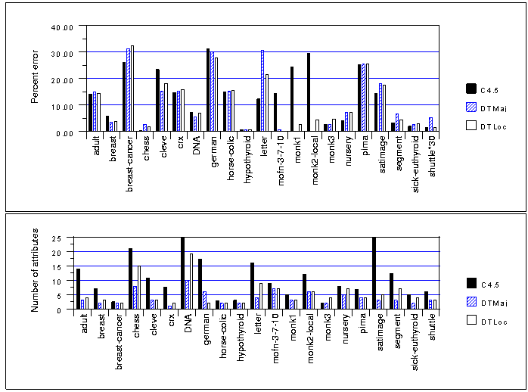

Slide 15
Empirical Evaluation Analysis
Decision tables will generally be inferior for multiple-class problems.
However, decision tables will generally be superior in noisy domains.
Decision tables use significantly less attributes than decision trees, for smaller and easier to understand classifiers.

Slide 16
Visualizing Decision Tables
Authors created a visualization tool for business users. Users can specify number of attributes and coarseness.
Visualization shows matrix of cakes at intersecting attribute values. Cakes have slices (representing labels) and height (number of records for the intersection).

Slide 17
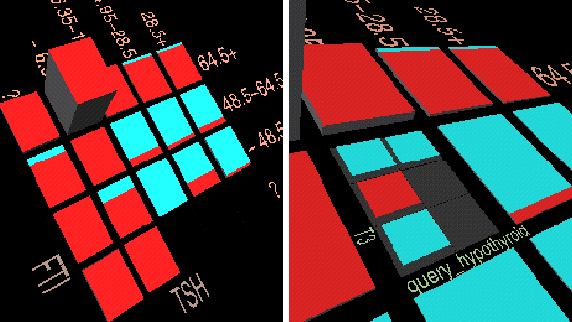
DT Visualization Screenshot

Slide 18
Conclusions
Decision table classifiers are easier for business users to understand than naïve Bayes or decision trees.
DTs use less attributes, allowing business users to better pinpoint attributes in need of attention.

Slide 19
Conclusions
For large datasets tested, DTCs with a very small number of attributes can generally match C4.5’s accuracy.
Decision table classifiers, with a good visualizer, make it easy for business users to classify records.

Slide 20
References
(Kohavi & Sommerfield 1998)
Targeting Business Users with Decision Table Classifiers
(Kohavi 1995)
The Power of Decision Tables
(Kohavi & Li 1995)
Oblivious Trees, Graphs, and Top-down Pruning

